Slide 1


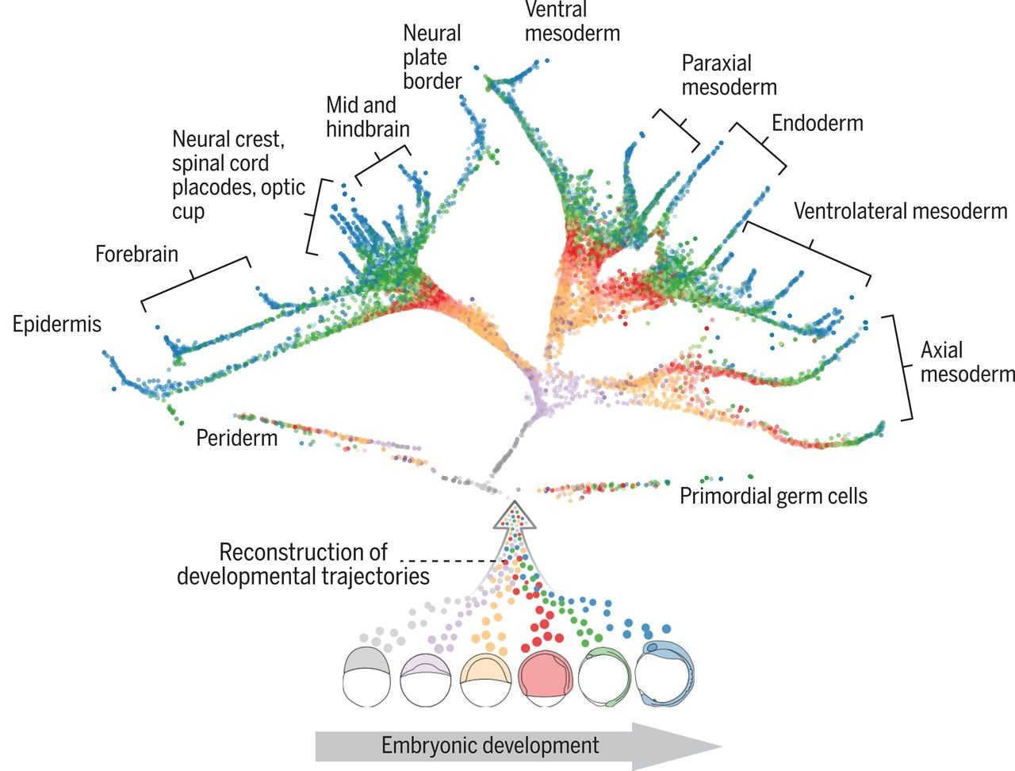
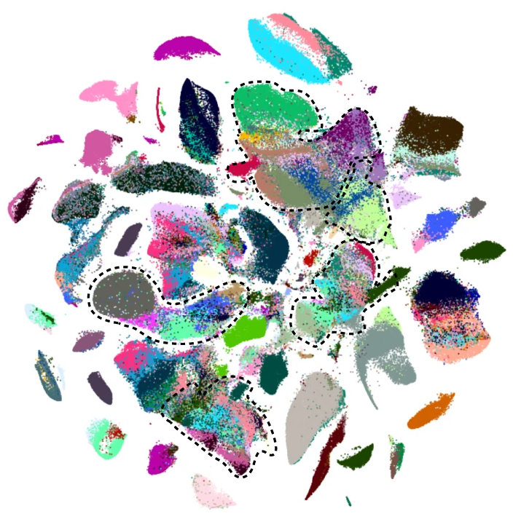
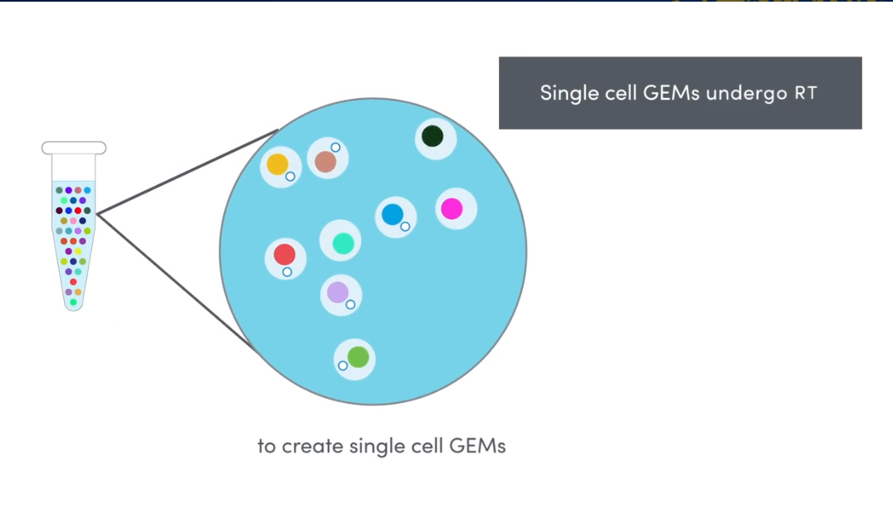
El lenguaje genético de las células: single-cell genomics

Slide 2
What is gene expression?

Slide 3

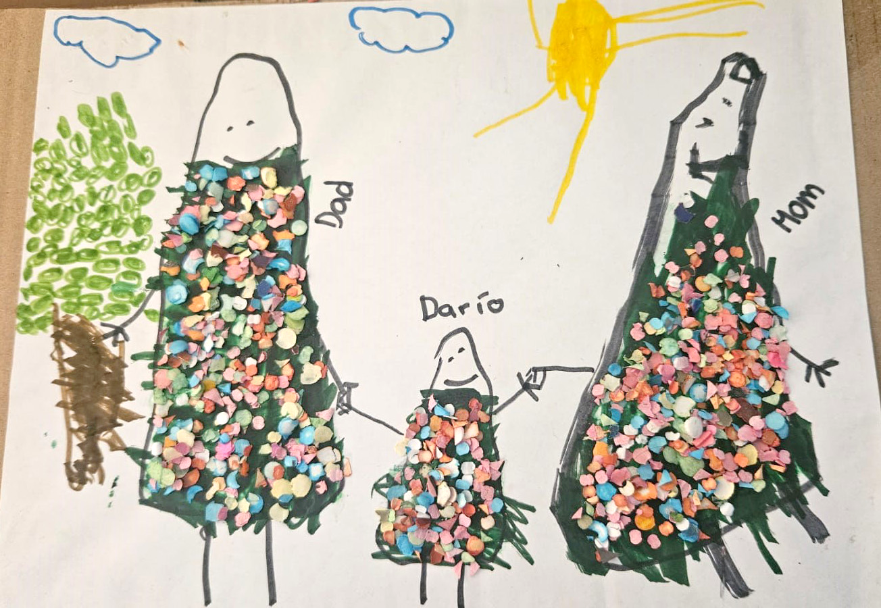

  Humans use creative expression to show individual´s ideas and thoughts

Slide 4
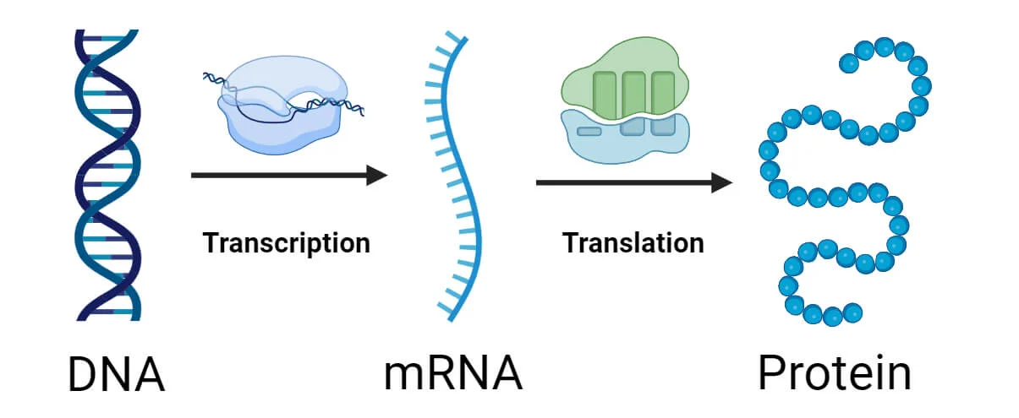
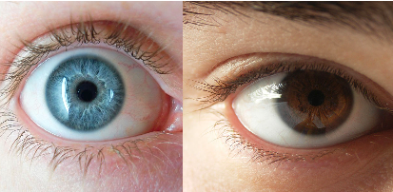
  Cells can express too using gene regulation

Slide 5
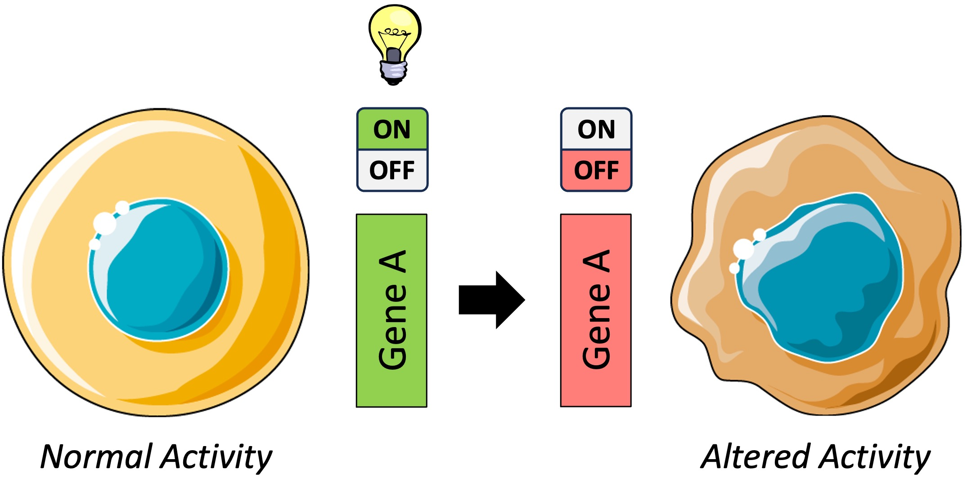
  Cells can express too using gene regulation

Slide 6
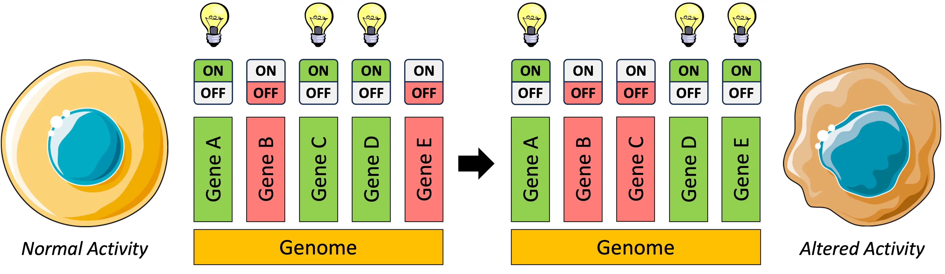
  Cells can express too using gene regulation

Slide 7
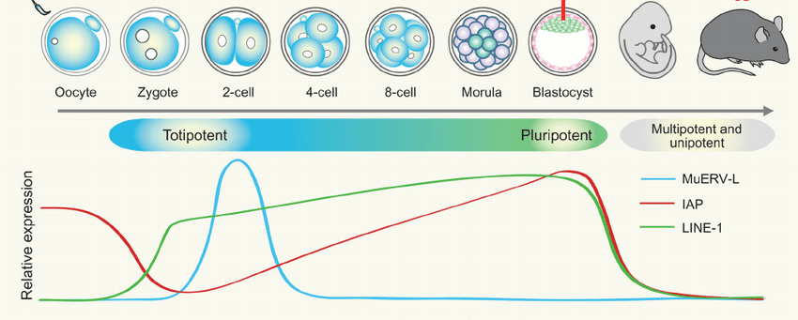
Development progresses through changes in gene expression

Slide 8
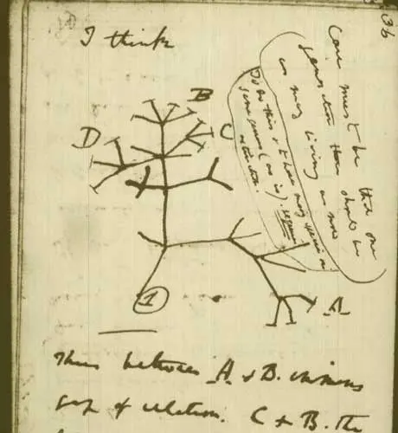
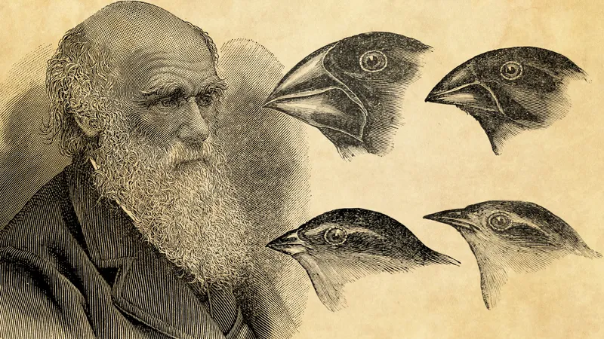
Evolution at the cellular level is poorly understood

Slide 9
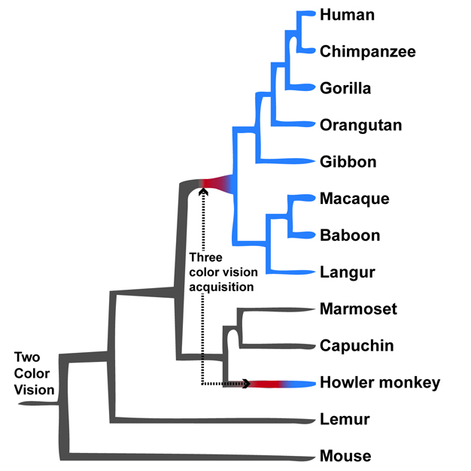
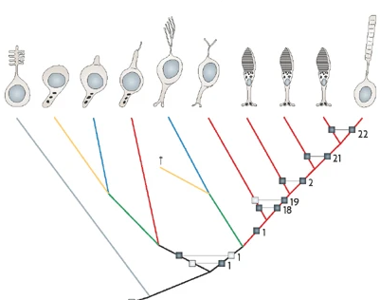
Evolution at the cellular level is poorly understood

Slide 10
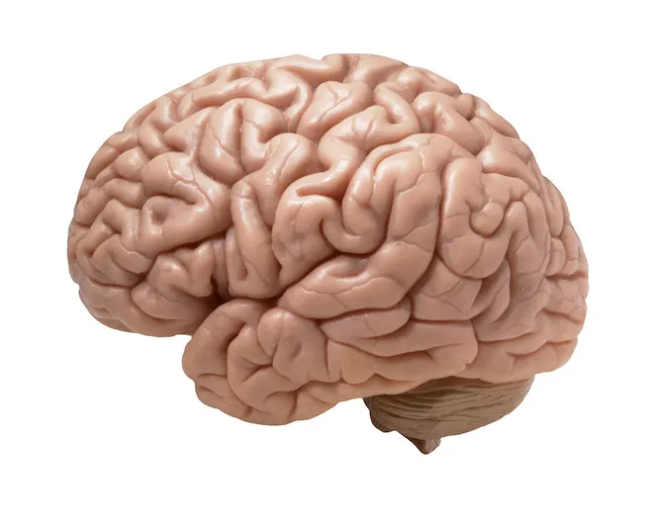


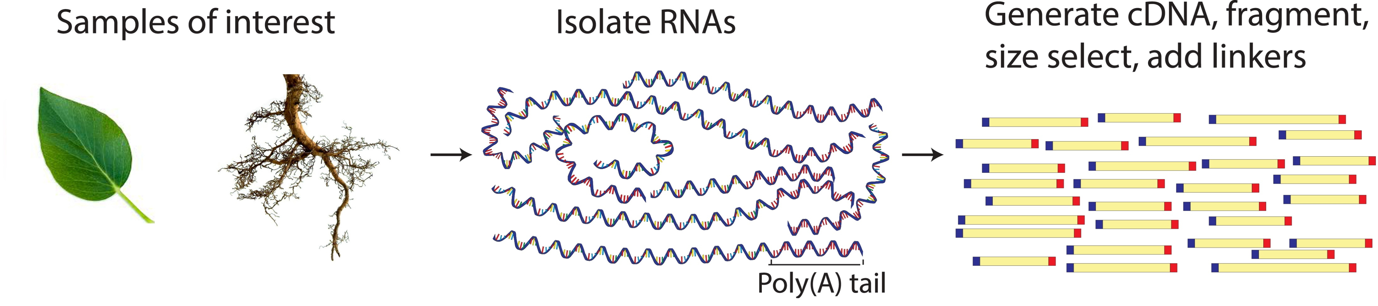
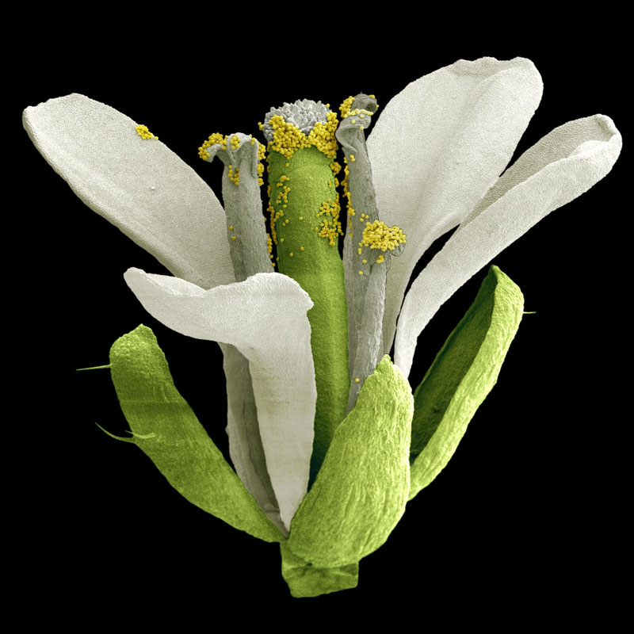
Gene expression characterization was traditionally done at the organ level

Slide 11
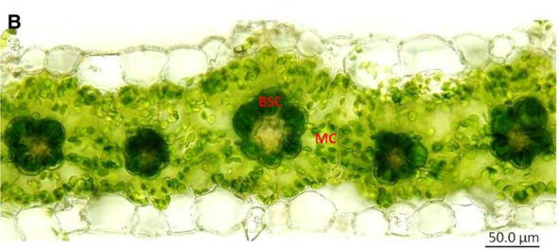
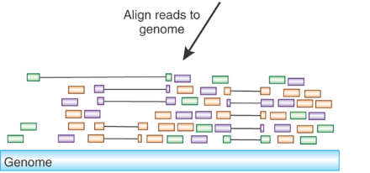
Single-cell RNAseq as a tool to discover developmental regulators

Slide 12
Droplet-based single-cell RNAseq: the emergence of a scalable system

Slide 13
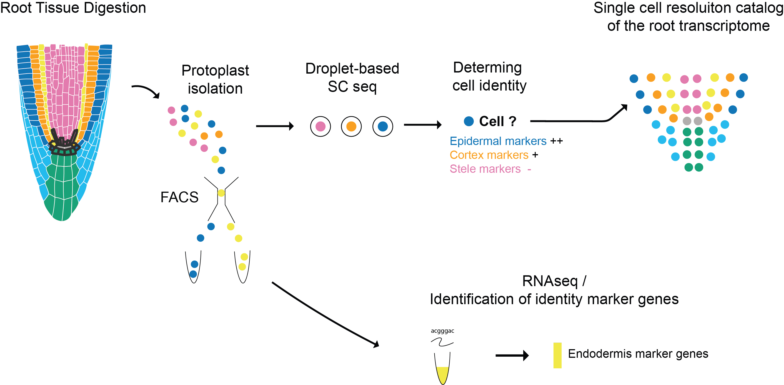
Single-cell RNAseq as a tool to discover developmental regulators
Notes:
Took decades in At, stepwise

Slide 14
Single-cell RNAseq as a tool to discover developmental regulators
Notes:
Took decades in At, stepwise

Slide 15
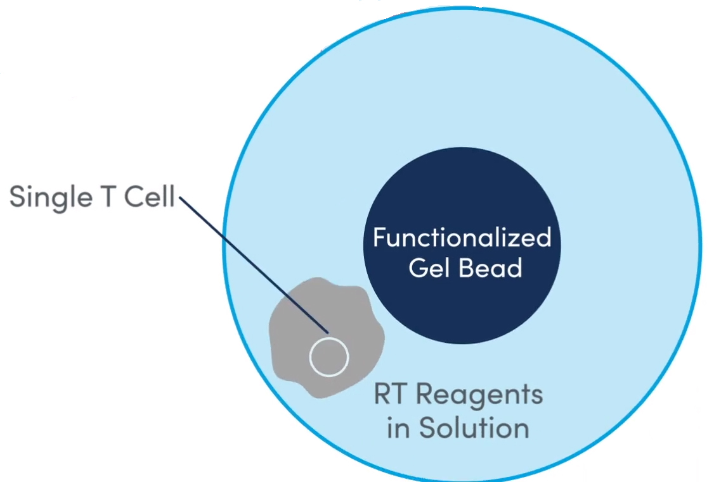
Single-cell RNAseq as a tool to discover developmental regulators
Notes:
Took decades in At, stepwise

Slide 16
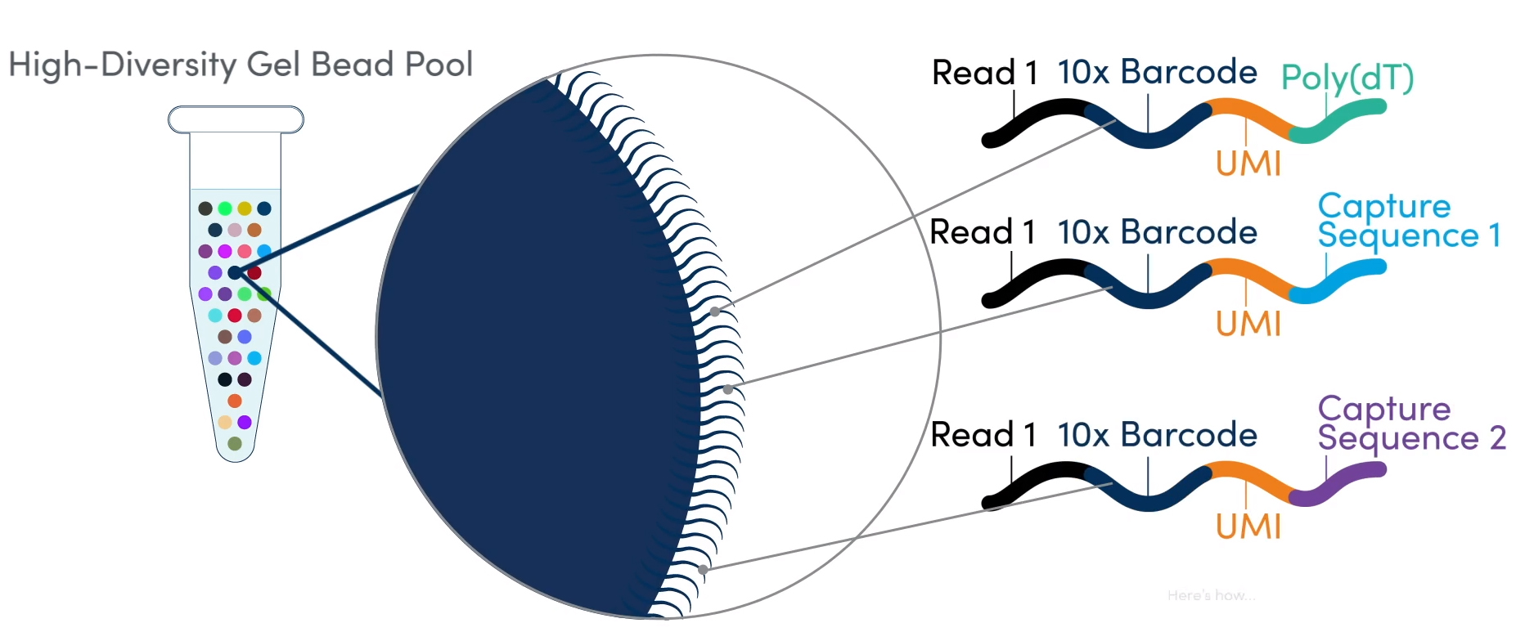
Single-cell RNAseq as a tool to discover developmental regulators

Slide 17
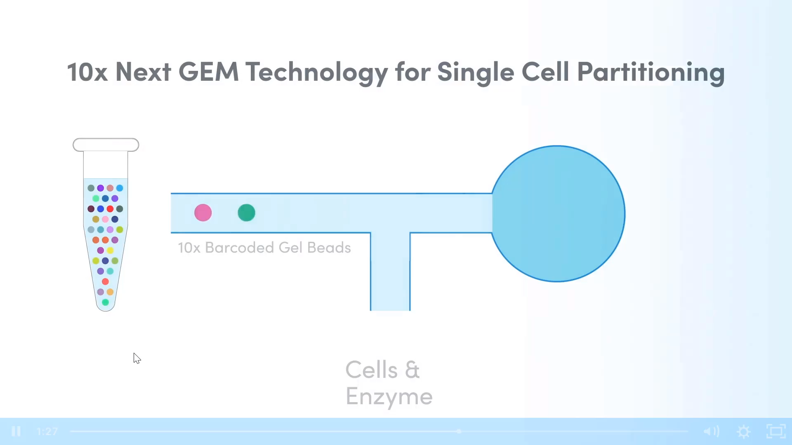

Slide 18
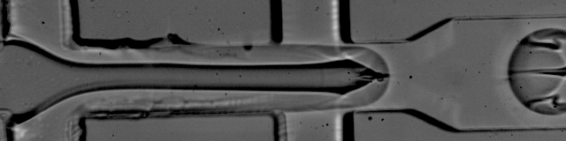

Slide 19
Single-cell RNAseq as a tool to discover developmental regulators

Slide 20
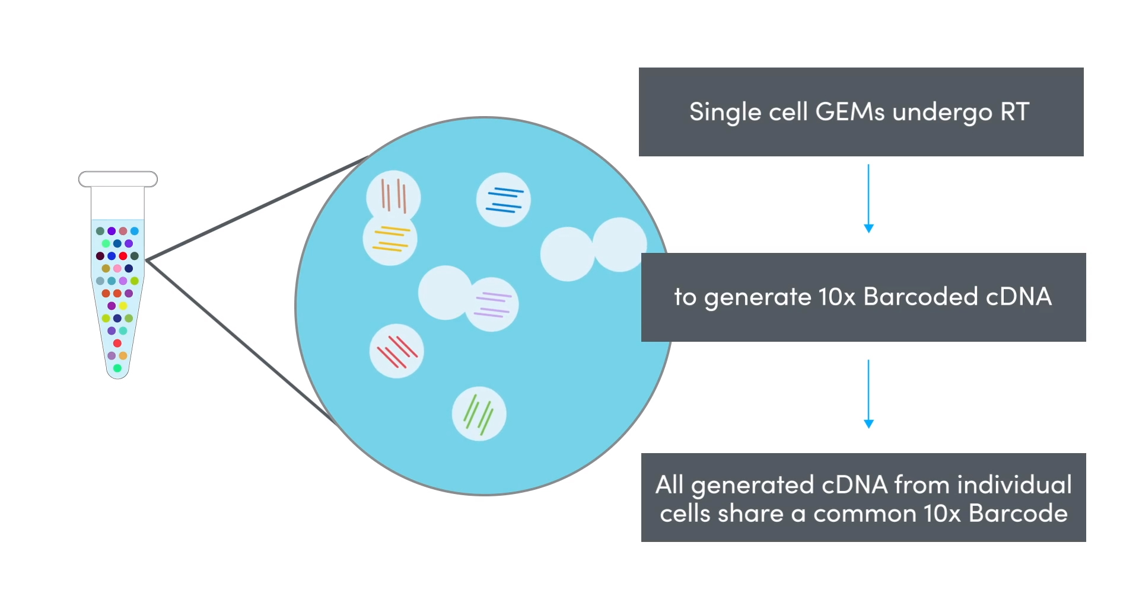
Single-cell RNAseq as a tool to discover developmental regulators

Slide 21
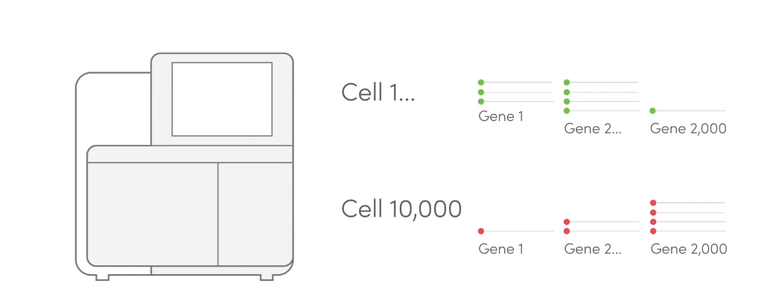
Thousands of genes can be assigned to a single cell

Slide 22
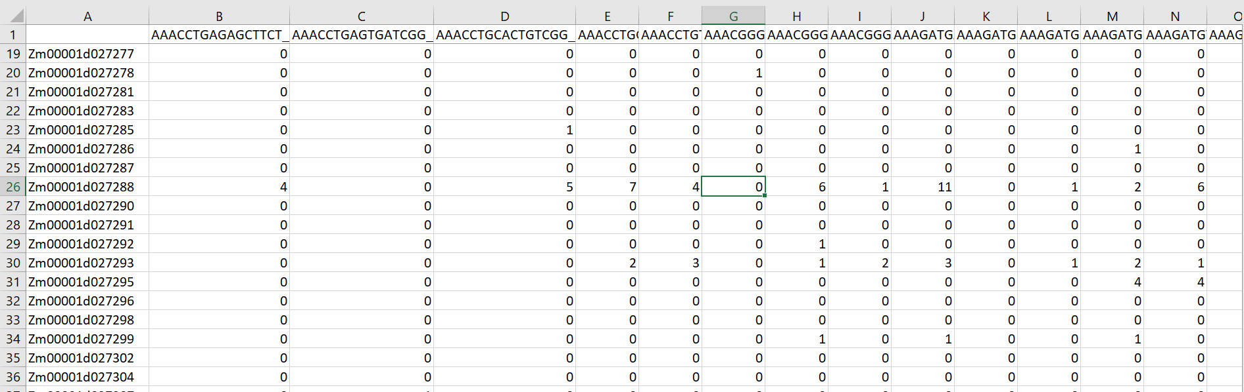
Single cell expression matrices

Slide 23
Single-cell RNAseq as a tool to discover developmental regulators
Notes:
Took decades in At, stepwise

Slide 24
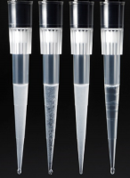
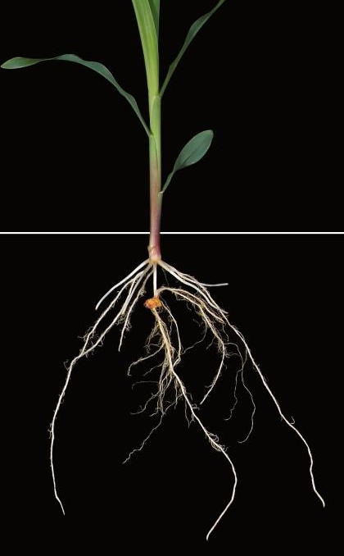
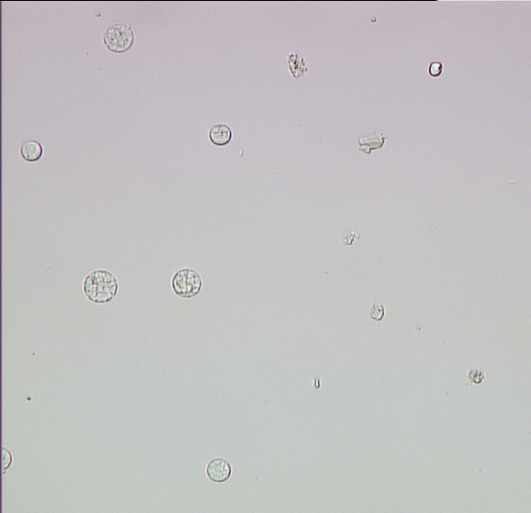
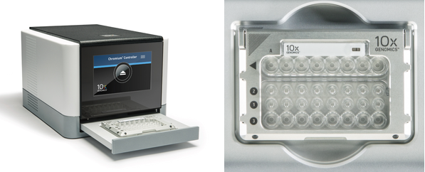
10x Runs

Slide 25
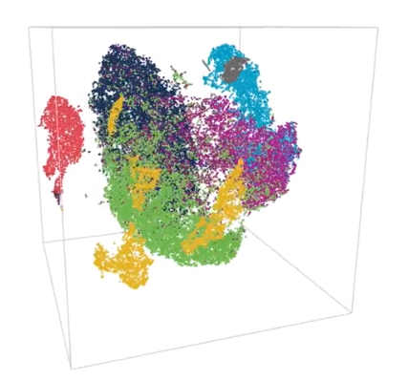
Applications
Cell type 1
1. Understanding tissue development and patterning.
2. Mapping Cellular heterogeneity.
3. Identifying rare cell types.
4. Cellular basis of evo-devo.
5. Cellular differentiation pathways
Cell type 2

Slide 26
1. Tissue patterning
Notes:
Que nos pueden decir estos datos sobre la biology’ia que hay detras del sistmea que estamos estudiando. Parte m’as interesante del an’alisis. Por ejemplo, Podemos cuantificar la expression de factores de transcripci’on de interes en tipos celulares de interes. Asi identificamos el factor SHR que tenia un patron muy interesante.

Slide 27
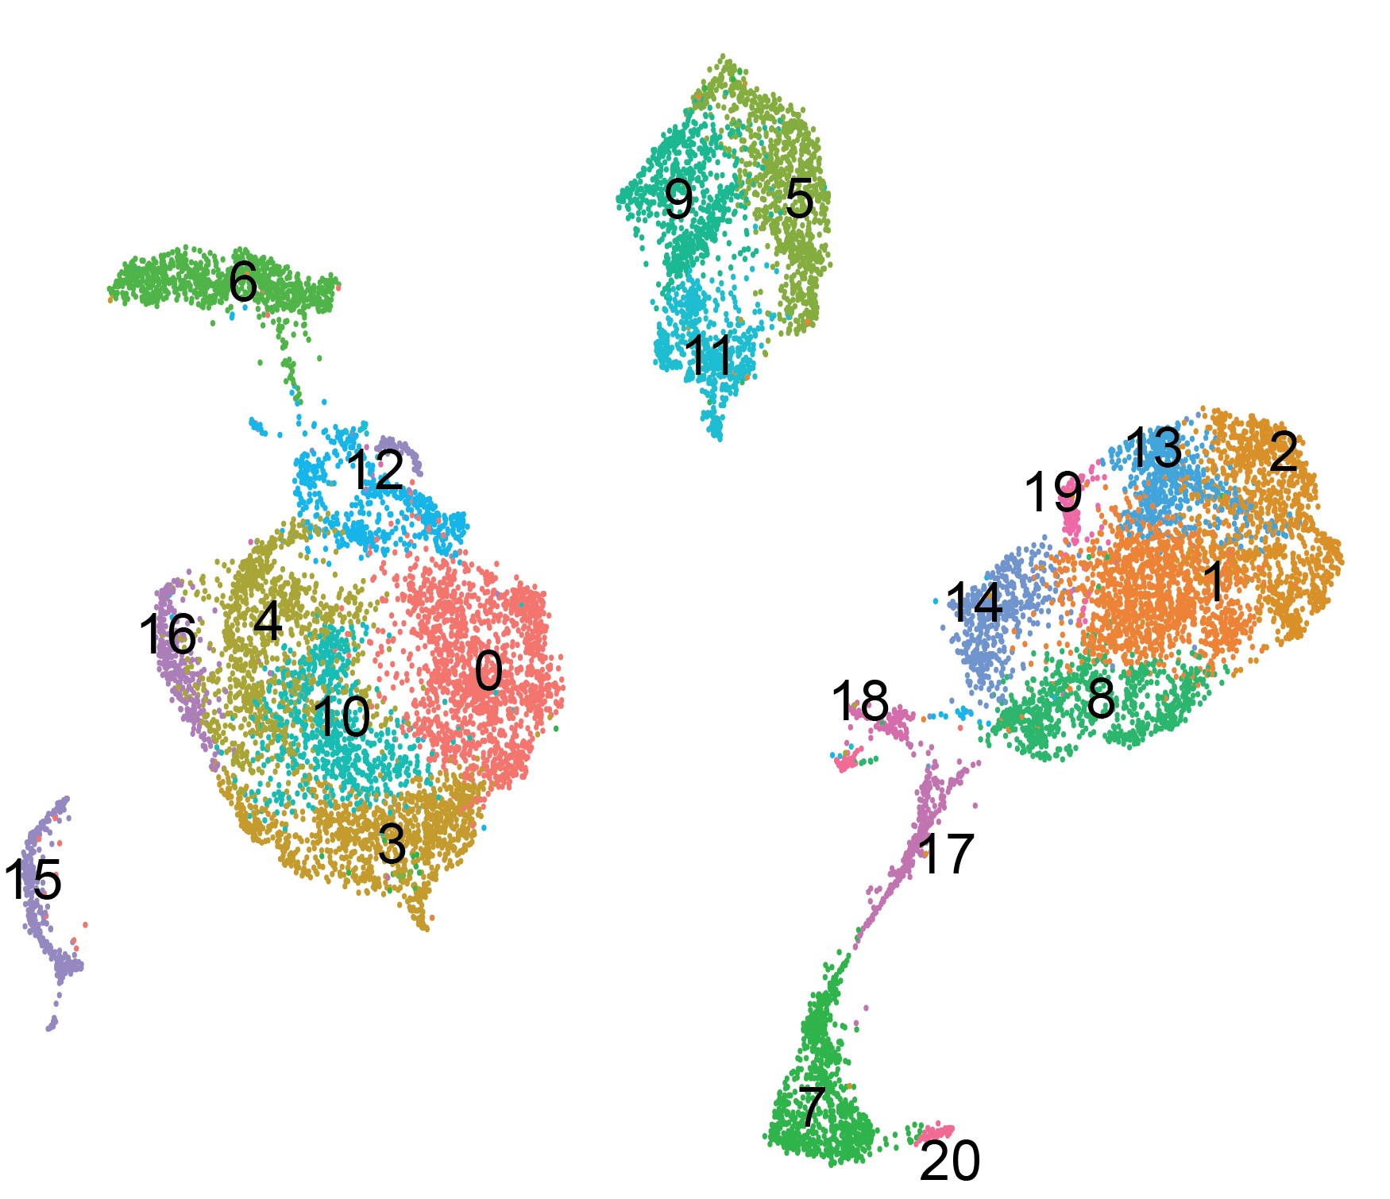
21 distinct cell-type populations were identified with scRNAseq
UMAP – cell subpopulations
≈ 14,755 cells
5683 genes/cell
21 cell clusters
Notes:
Para contester la primera pregunta hicimos.. Y lo que les maestro aqui es una representacion grafica de los datos de single cell… las celulas estan agrupadas por la similitude de su programa transcripcional

Slide 28
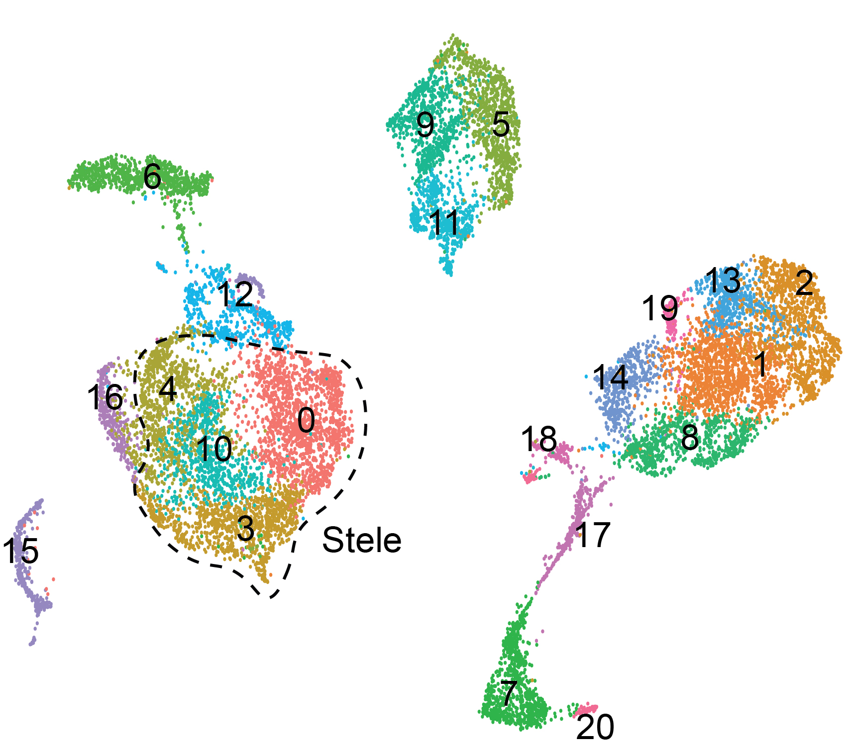
Multiple cortex and stele cell subpopulations were discovered

Slide 29
Multiple cortex and stele cell subpopulations were discovered
Periciclo
Floema

Slide 30
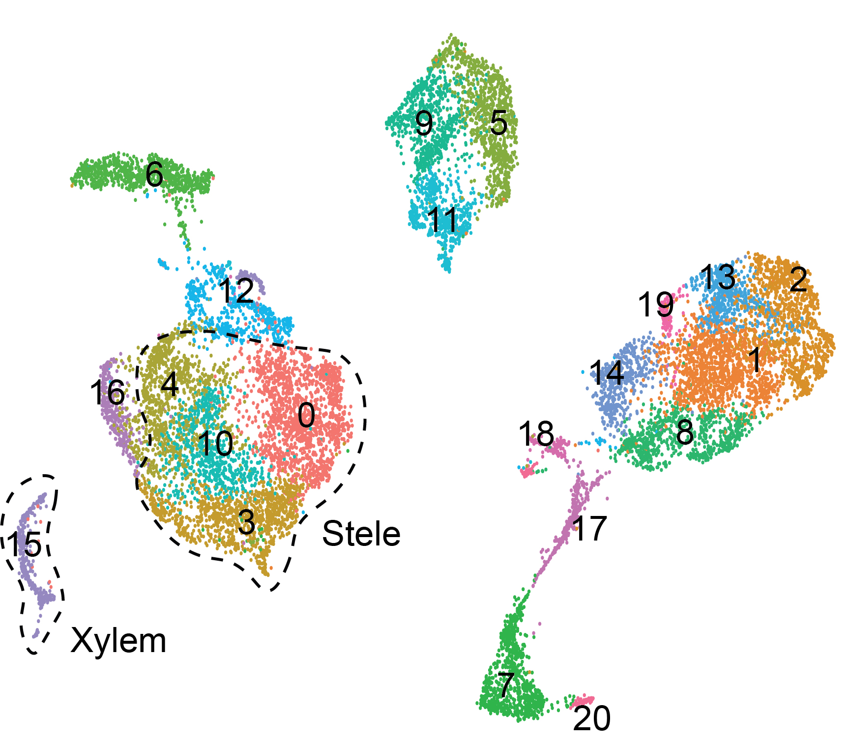
Multiple cortex and stele cell subpopulations were discovered

Slide 31
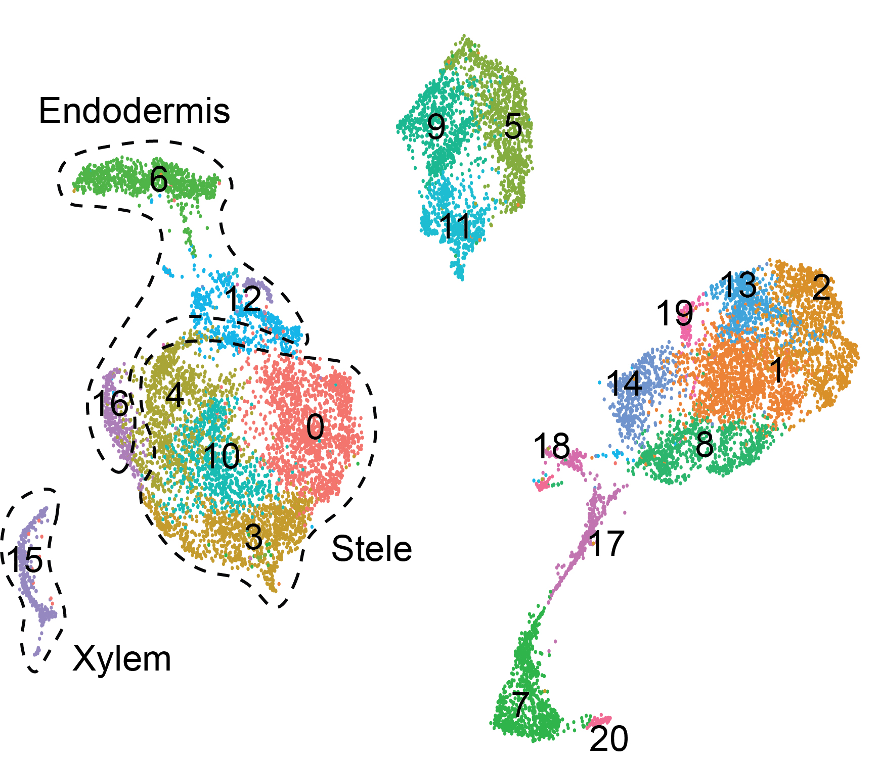
Multiple cortex and stele cell subpopulations were discovered

Slide 32
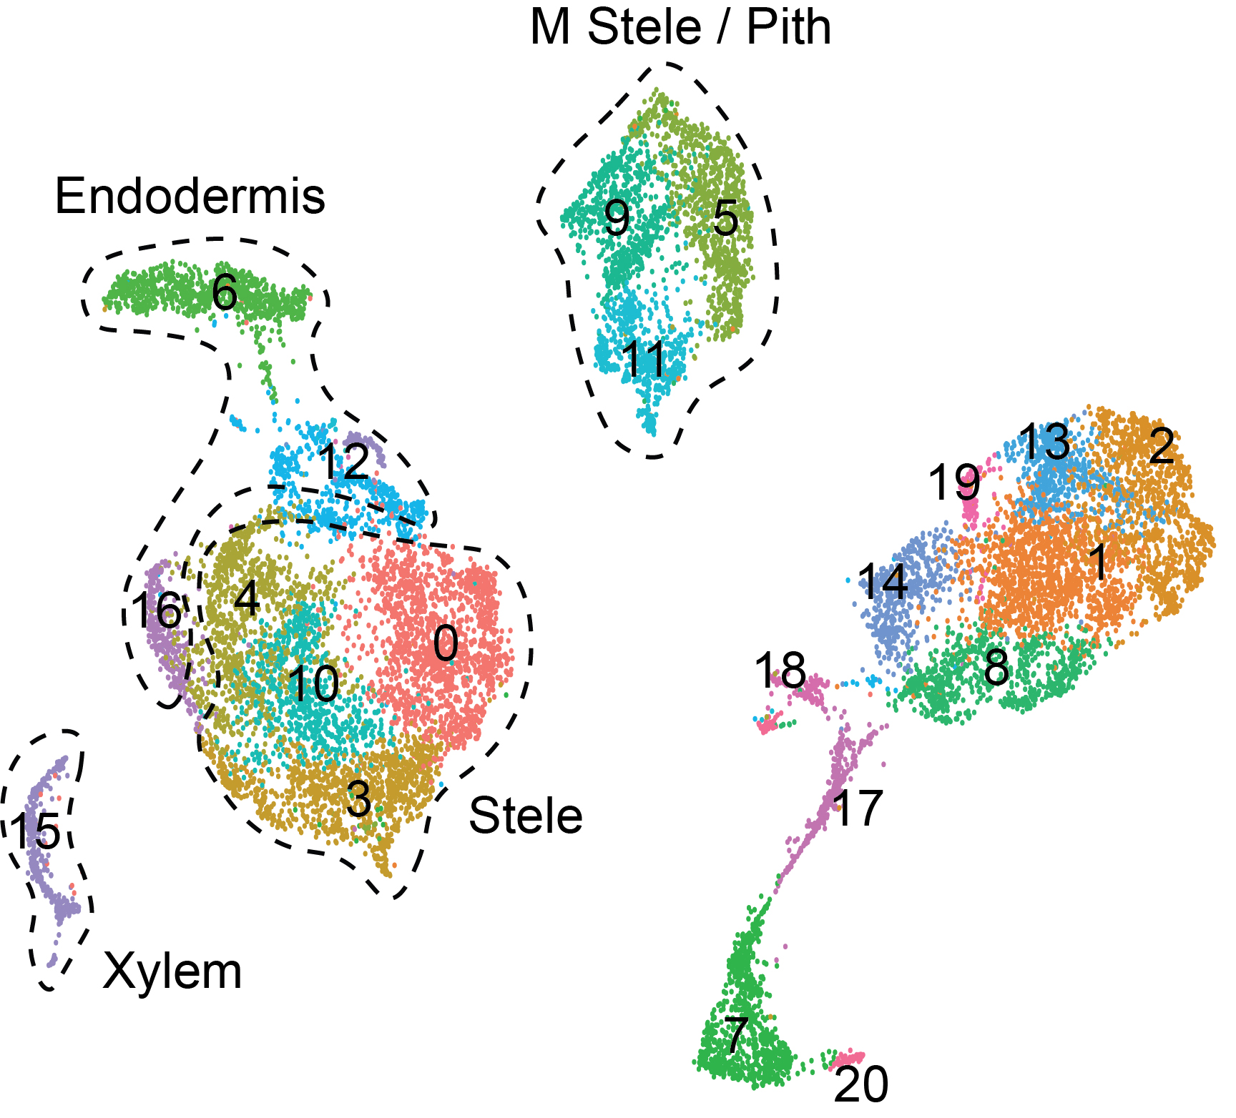
Multiple cortex and stele cell subpopulations were discovered

Slide 33
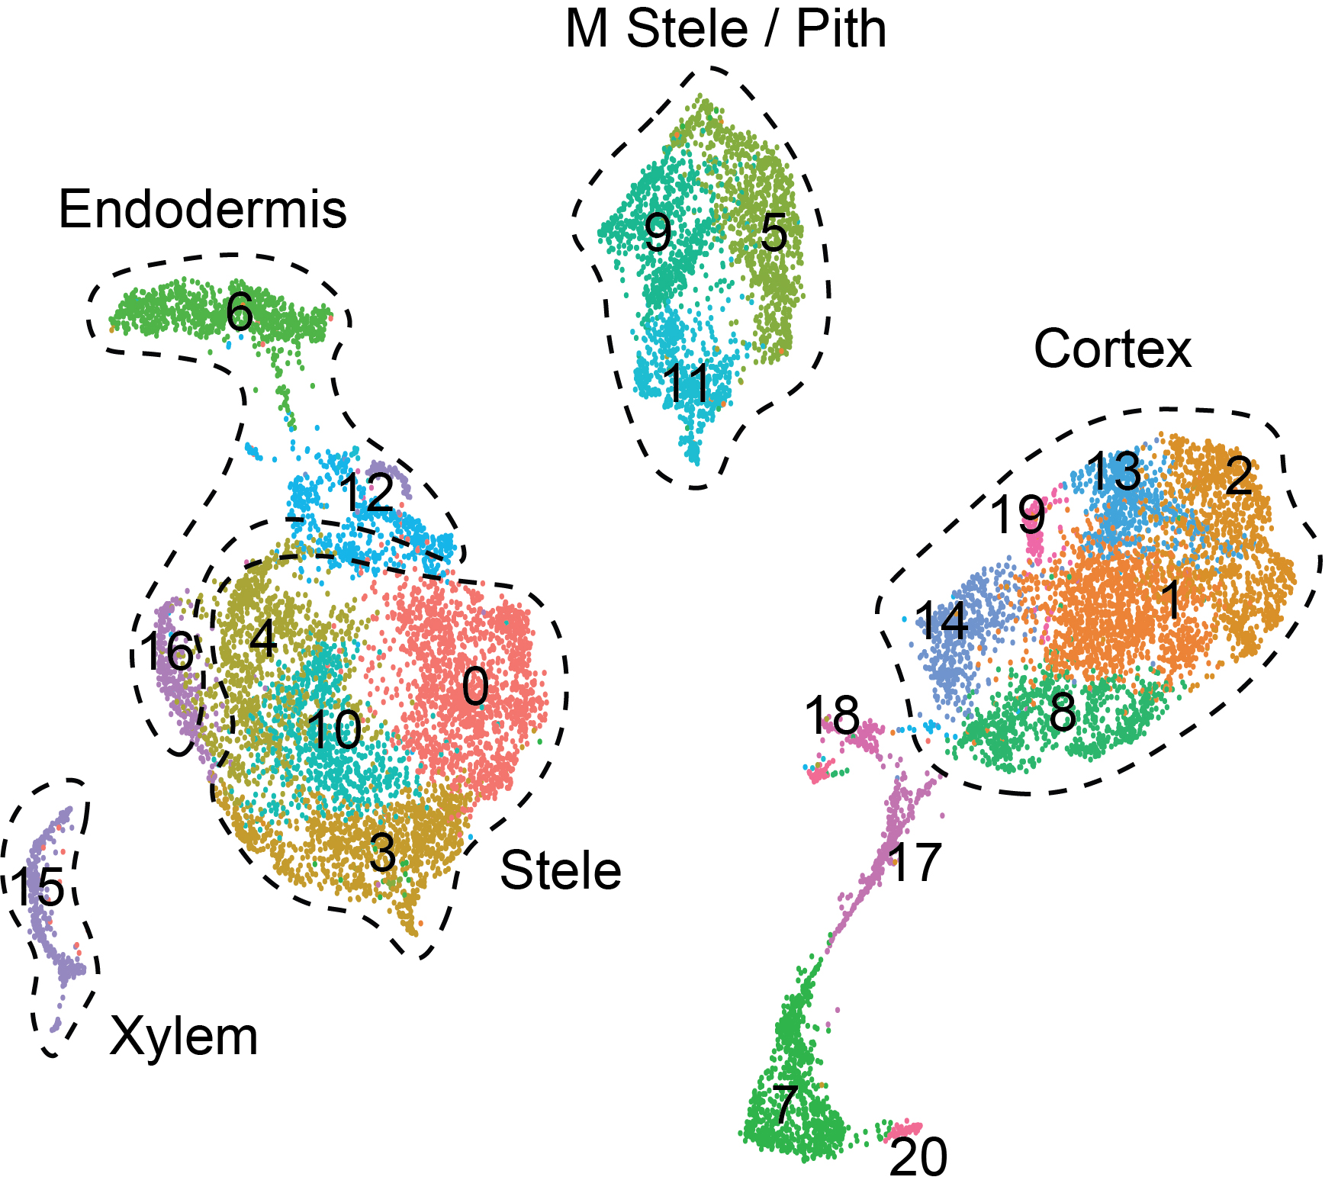
Multiple cortex and stele cell subpopulations were discovered

Slide 34

Multiple cortex and stele cell subpopulations were discovered

Slide 35
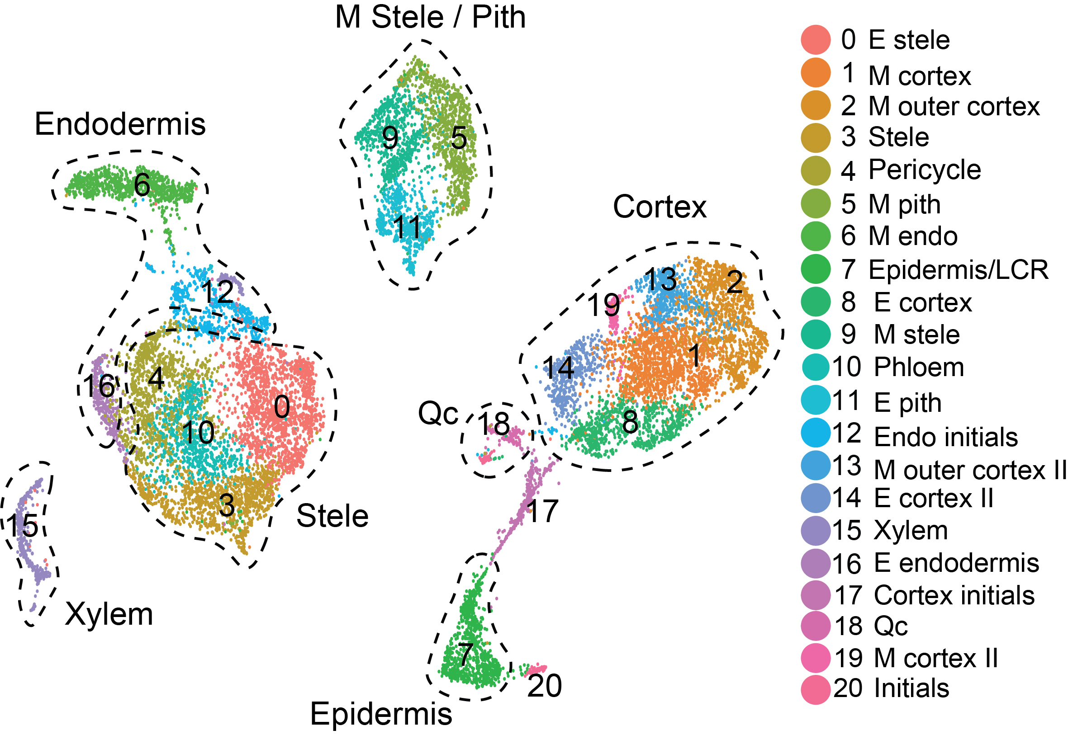
Multiple cortex and stele cell subpopulations were discovered

Slide 36
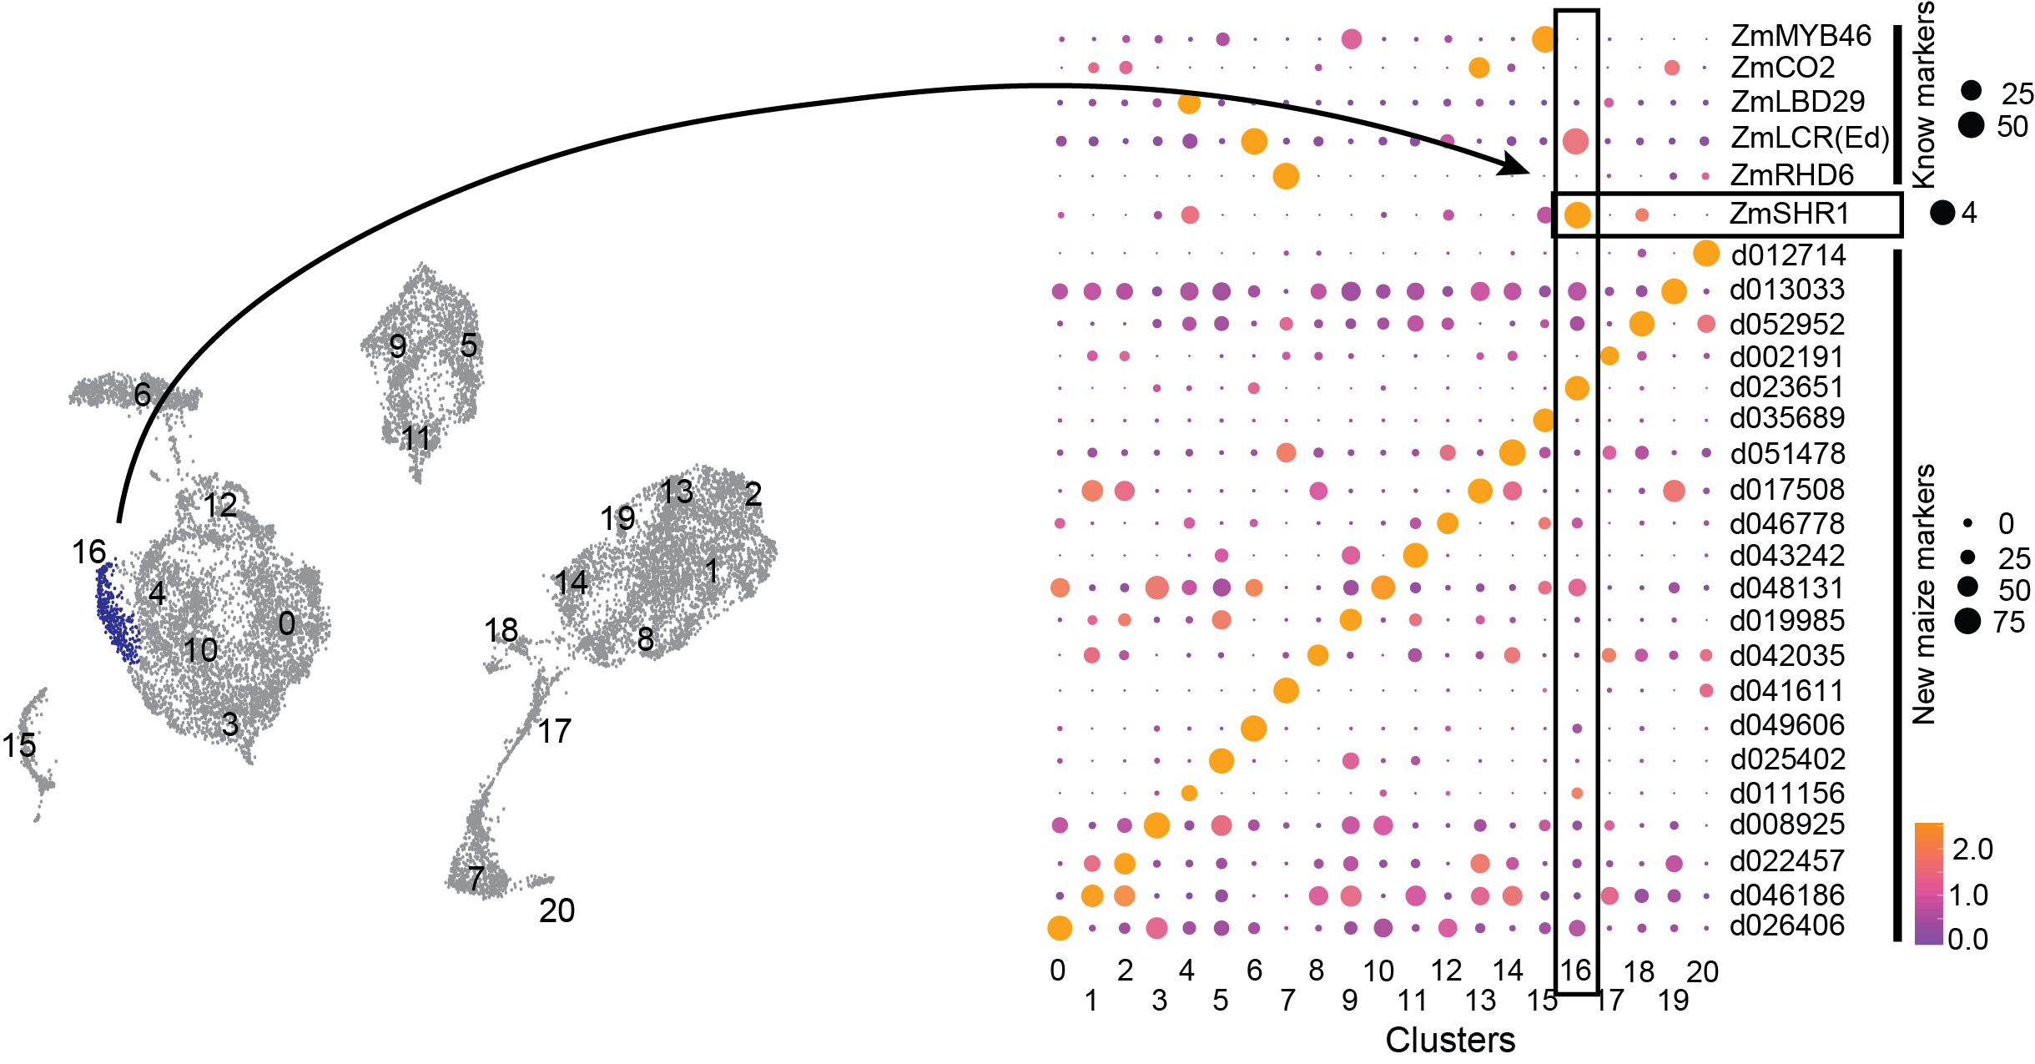
Se identificaron genes con expresión tejido-específica
Notes:
More information on shr/scr

Slide 37
The biology behind single-cell

Slide 38
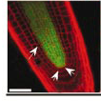
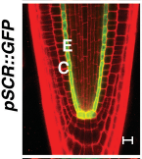
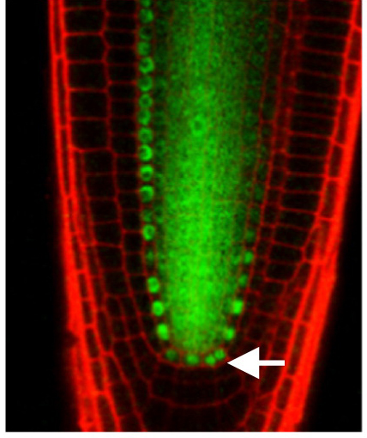
SHR determines root radial patterning
Arabidopsis expression
AtSHR::SHR-GFP
AtSCR::GFP
AtSHR::GFP
Nakajima et al. 2001
Müller et al. 2015
Notes:
More information on shr/scr

Slide 39
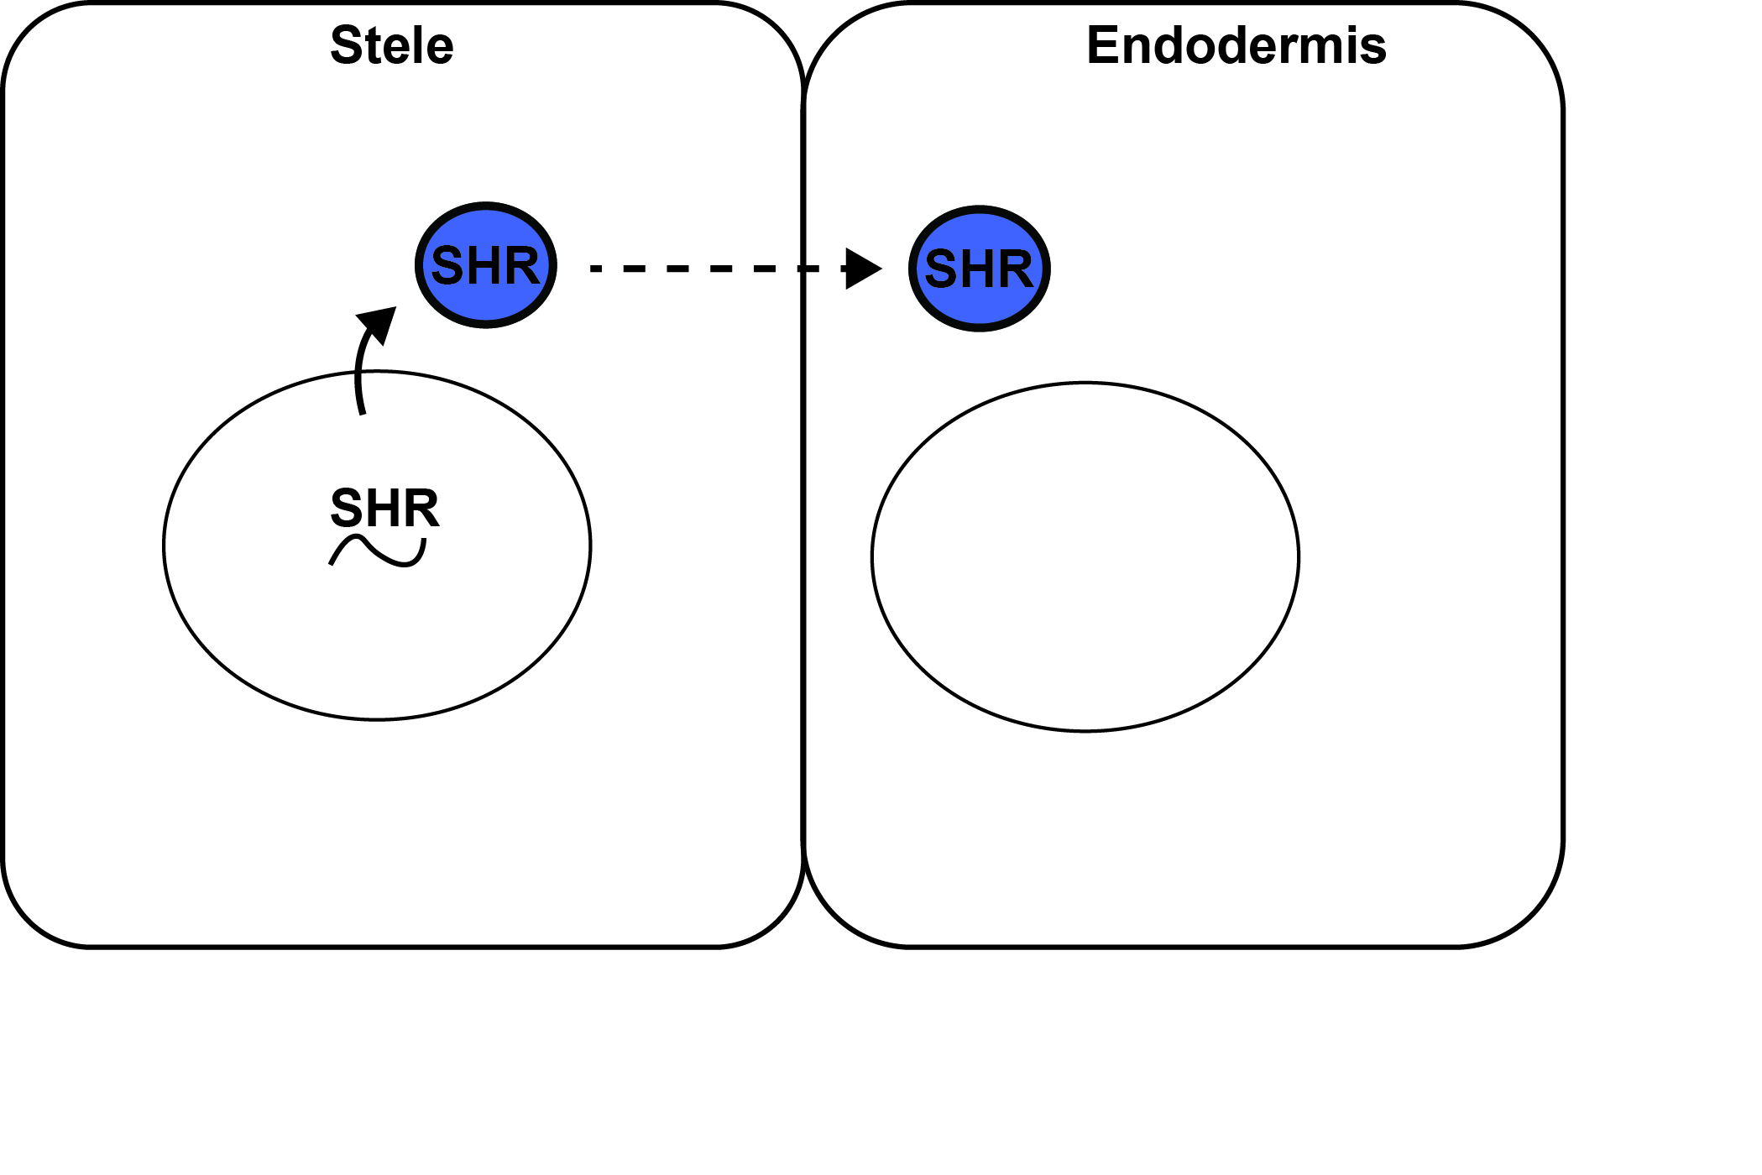
SHR and SCR genetic circuit triggers cell division

Slide 40
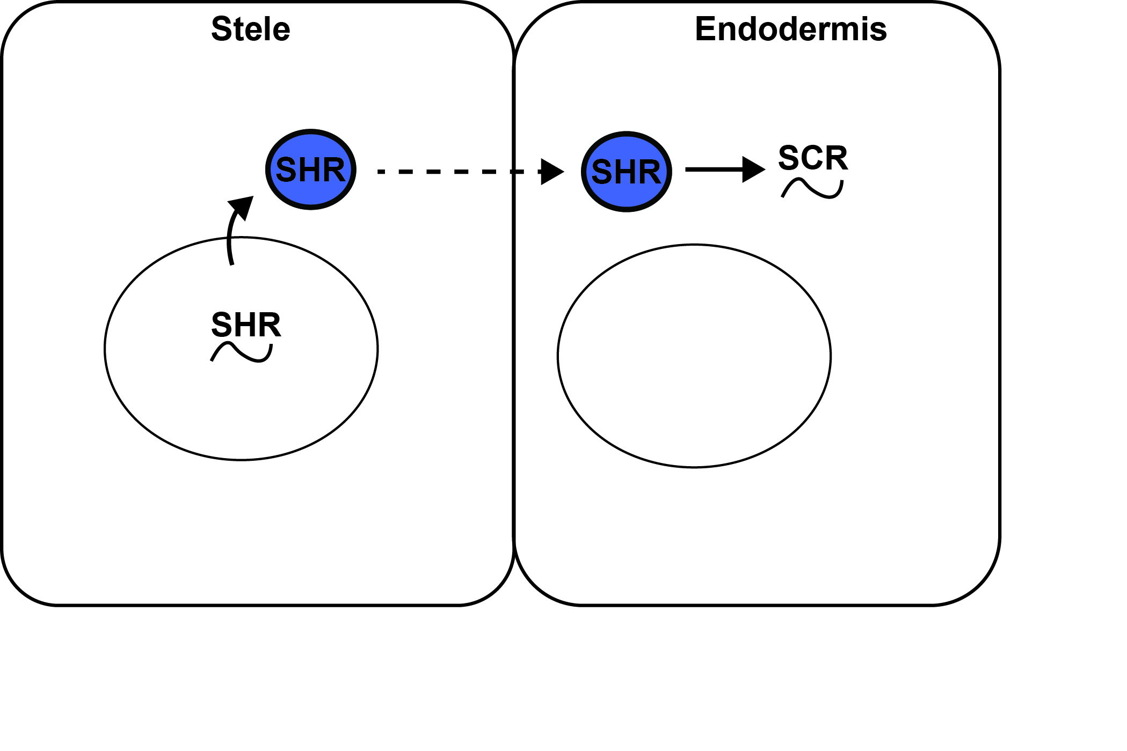
SHR and SCR genetic circuit triggers cell division

Slide 41
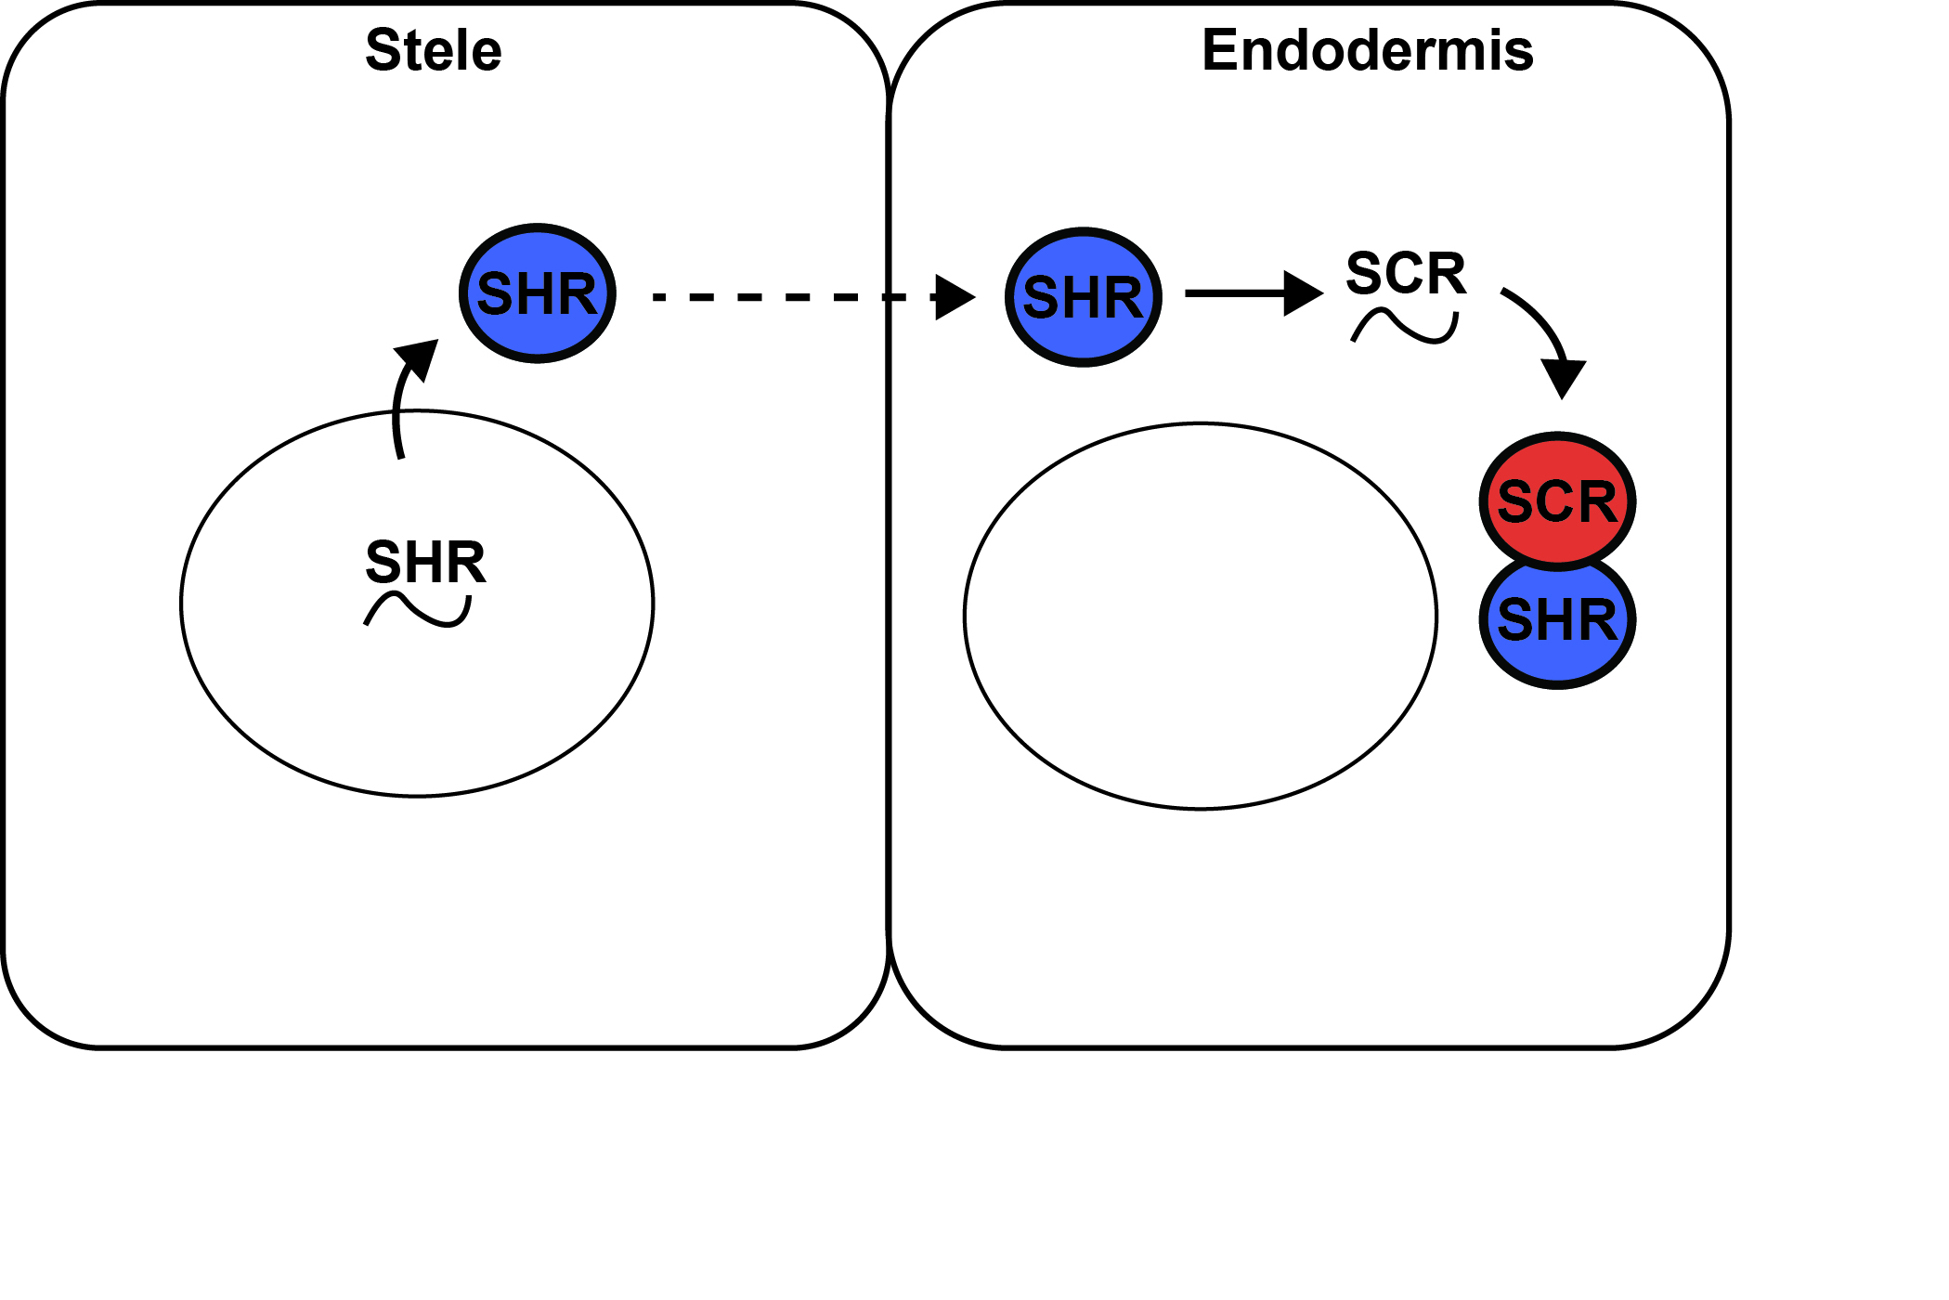
SHR and SCR genetic circuit triggers cell division

Slide 42
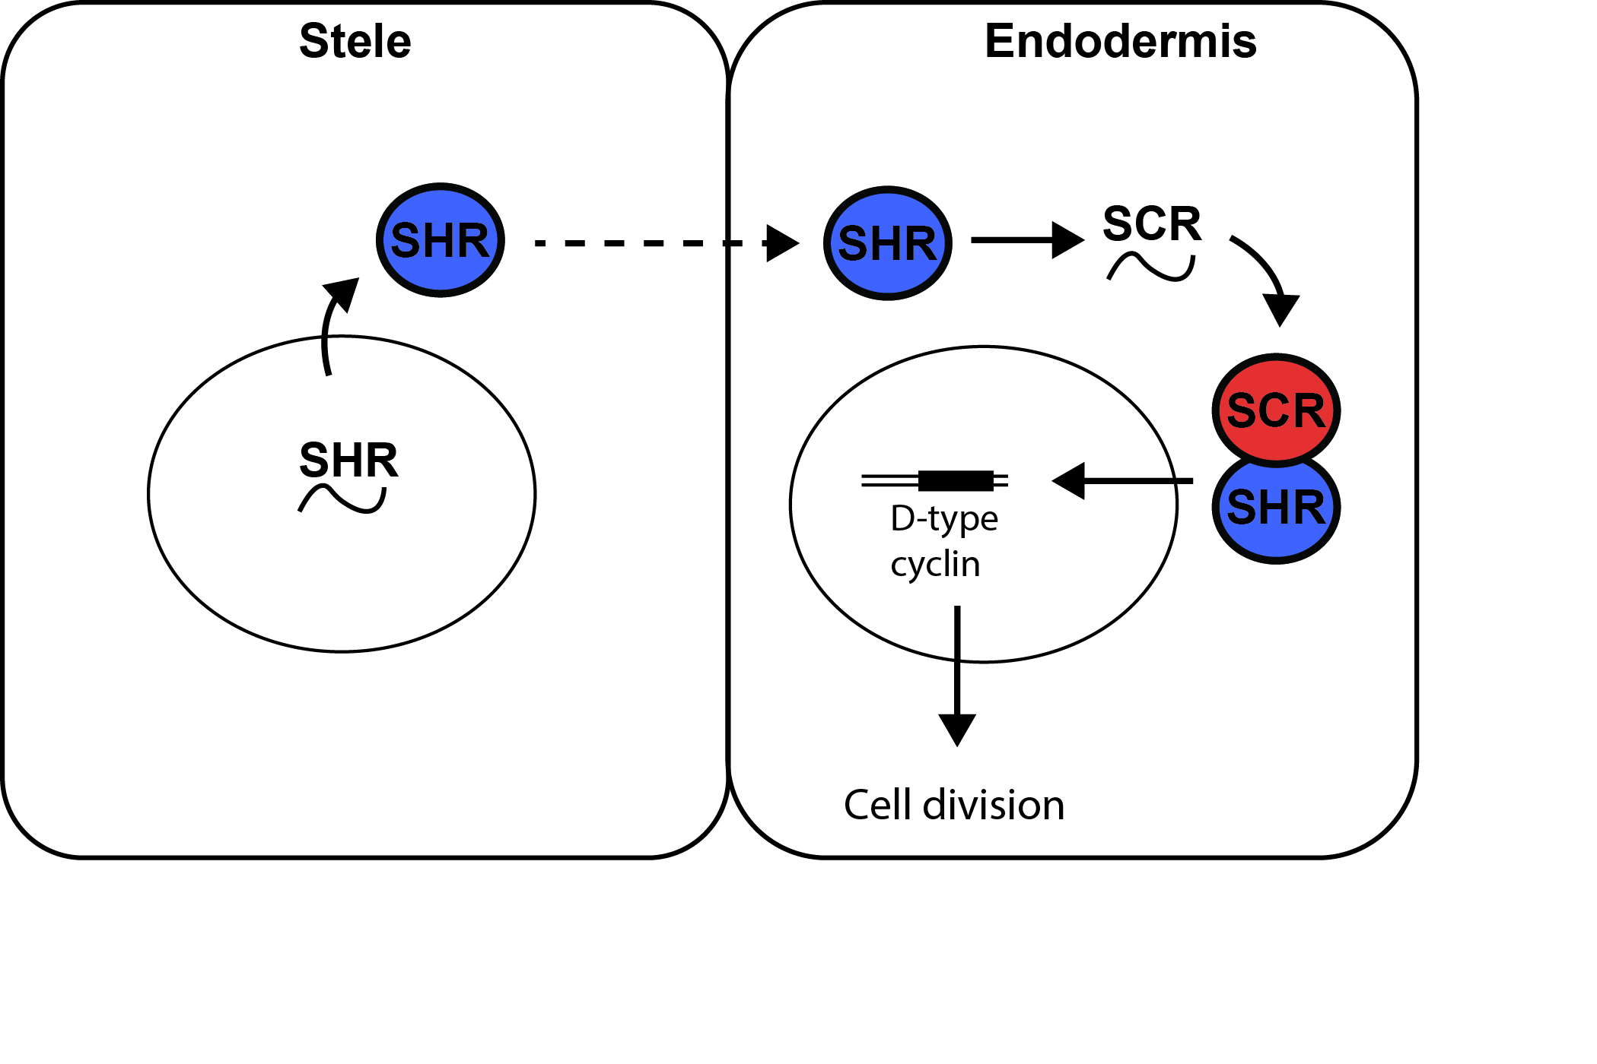
SHR and SCR genetic circuit triggers cell division

Slide 43
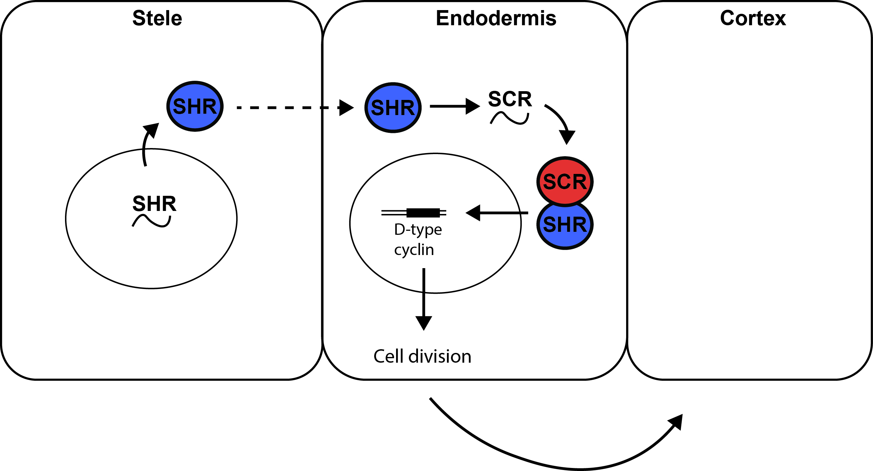
SHR and SCR genetic circuit triggers cell division

Slide 44

SHR and SCR genetic circuit triggers cell division

Slide 45
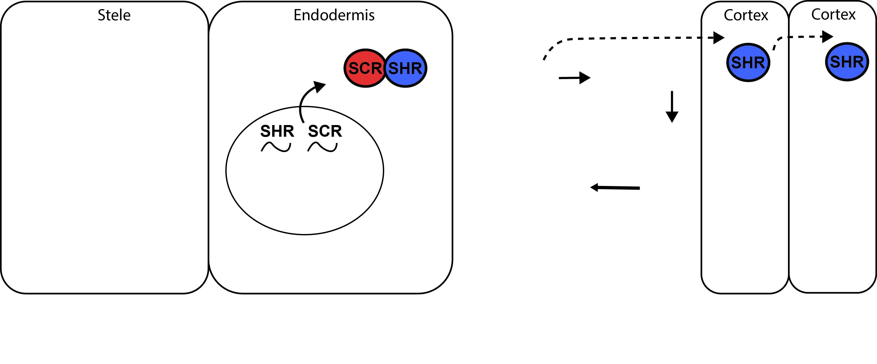
A new model for root radial patterning

Slide 46
Short root has a different expression pattern and movement
SHR transcript
SHR protein
Maize root
Arabidopsis root
Maize root
Arabidopsis root
pZmSHR::4NLS-TagRFPt
pZmSHR::SHR-GFP
S
C
S
C
Ed
Ed
E
Nakajima et al. 2001
Nakajima et al. 2001
S
C
Notes:
Incraese brightness

Slide 47
A new model for root radial patterning

Slide 48
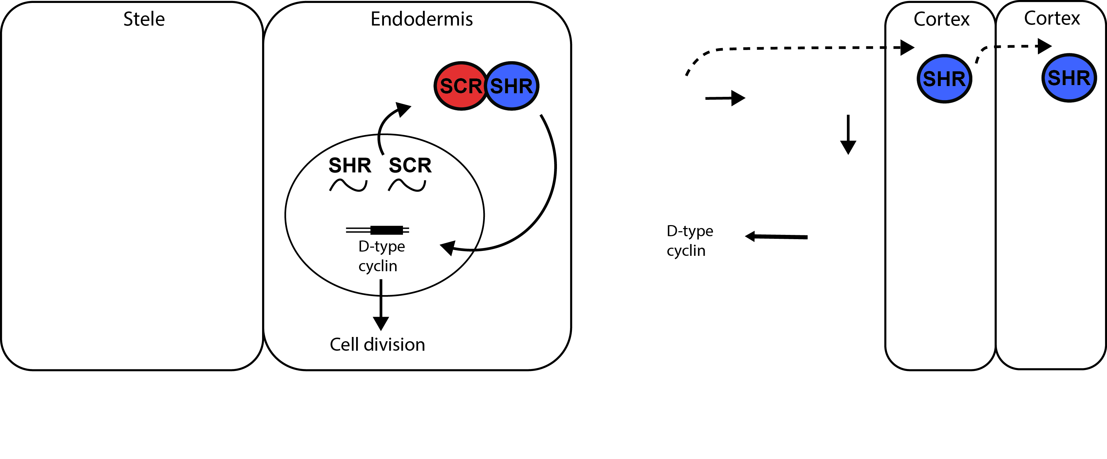
A new model for root radial patterning

Slide 49
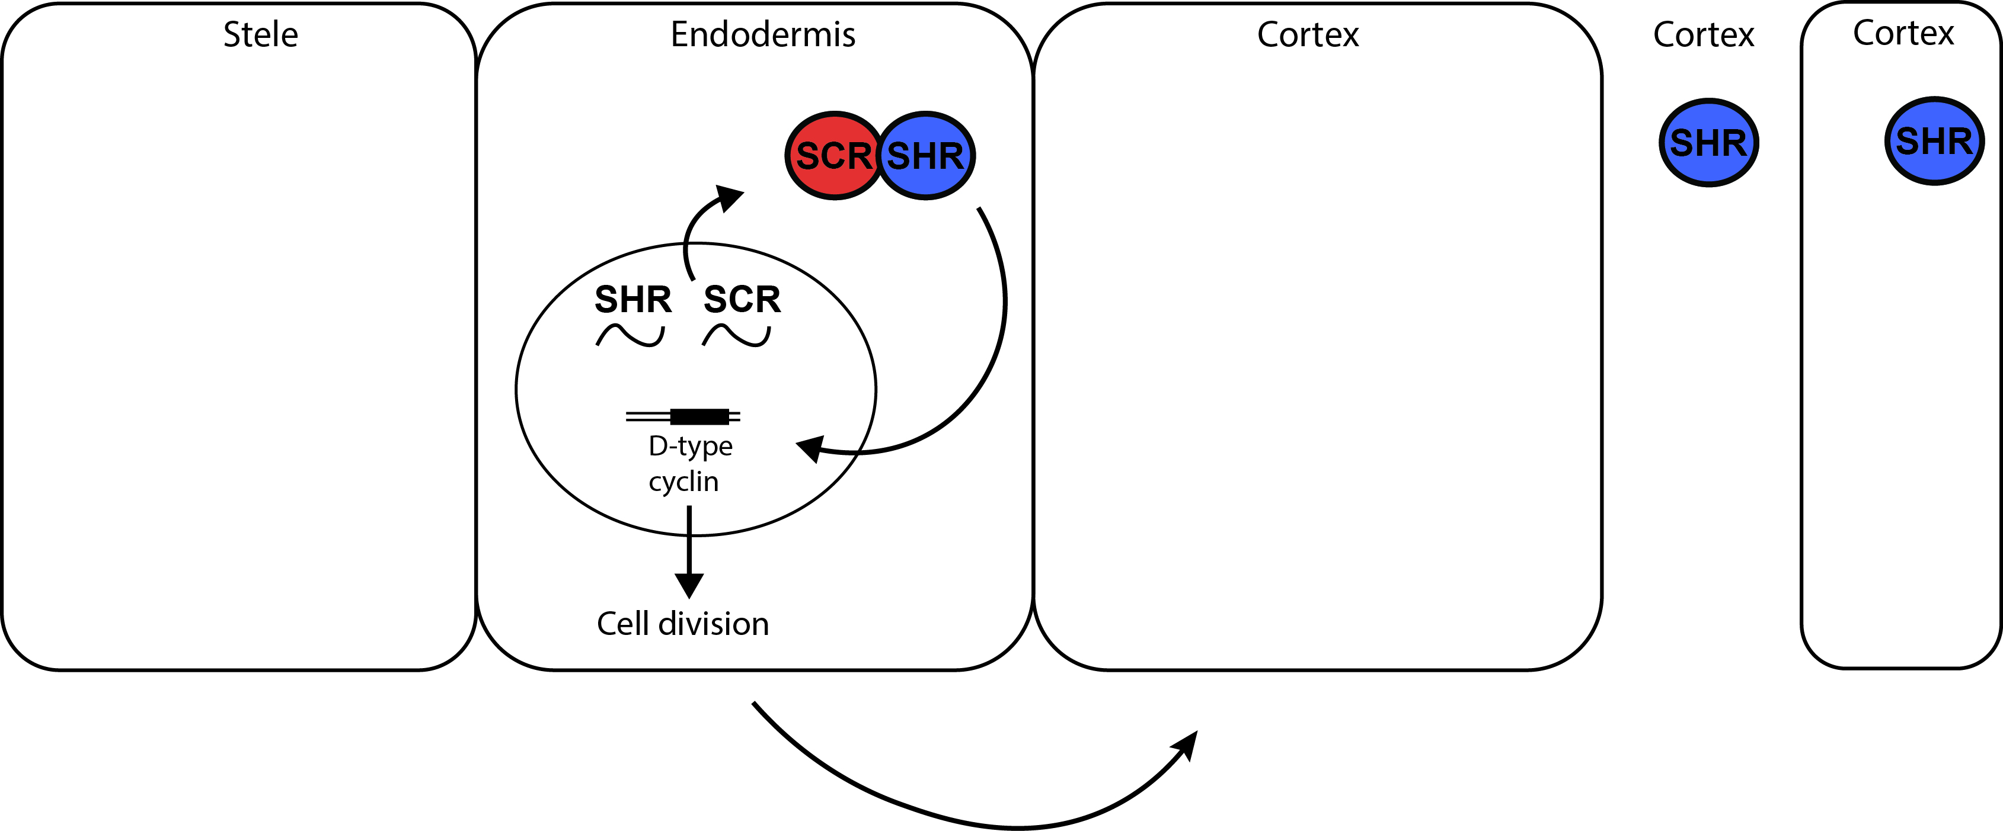
A new model for root radial patterning

Slide 50

A new model for root radial patterning

Slide 51

A new model for root radial patterning

Slide 52

A new model for root radial patterning

Slide 53

A new model for root radial patterning

Slide 54

A new model for root radial patterning

Slide 55

Maize CRISPR mutants
*Single base deletions
SviSHR1
Gras domain
SviSHR2
Gras domain
SviSHR3
Gras domain
Notes:
Change the colors

Slide 56

Edición genética por CRISPR produce raíces con menos cortex

Slide 57

Maize
Arabidopsis

Slide 58



Raíces mas delgadas penetran mejor suelos compactos
50% más biomasa y productividad
Chimungu et al., 2014
Notes:
Esto no solo es importante desde punto de vista del conocimiento basico sino que Tambien tiene un sentido aplicado. Y espero con este ejemplo poder convencerlos de eso…

Slide 59


Raíces mas delgadas penetran mejor suelos compactos
B73
CRISPR
Direct edition
Correa et al. 2019

